Slide 1
My First steps in Slit spectroscopy
BAAVSS Spectroscopy Workshop
Norman Lockyer Observatory October 2015
Andrew Wilson

Slide 2
Overview
My choice of spectrograph, camera and telescope
Getting started and basic processing
Some of the problems I’ve overcome
More advanced processing
Interspersed with examples of my spectra

Slide 3
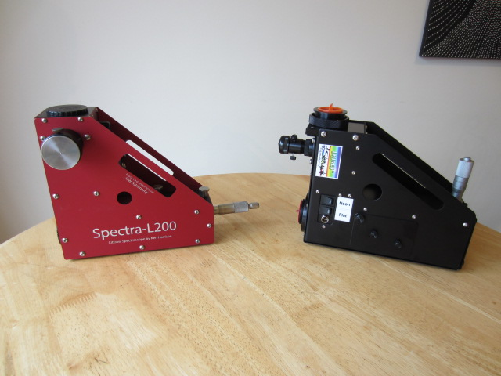
Spectrographs I’ve Used
Littrow Spectrographs - L200 & LHIRES III
Both use interchangeable diffraction gratings

Slide 4
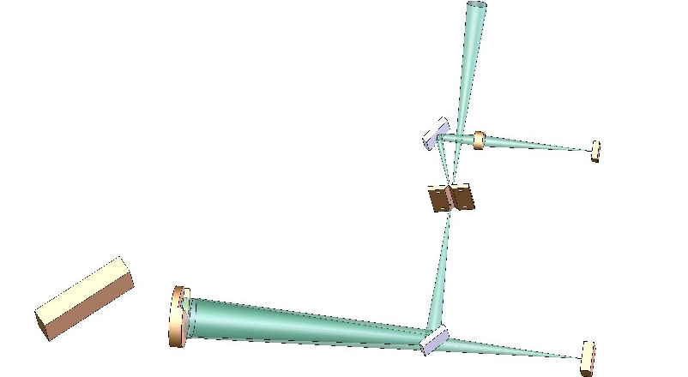
SHEYAK INSTRUMENTS LHIRES III
LHIRES III – Littrow Configuration
LHIRES III user manual

Slide 5
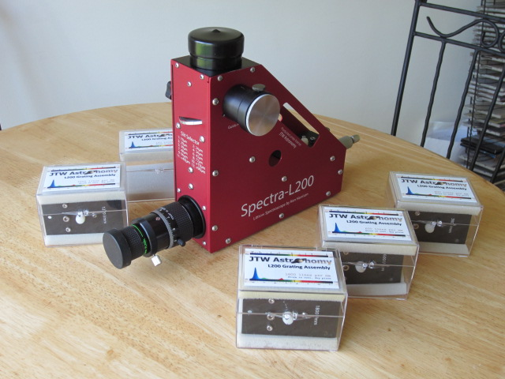
L200
Ken Harrison design built by JTW
Multiple gratings
Optimised for R3000 = 2 Angstroms at H-Alpha

Slide 6
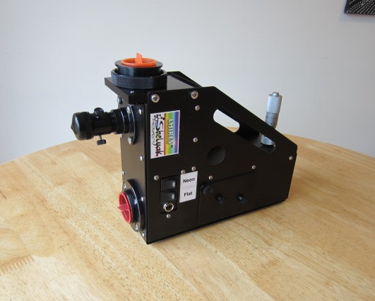
LHIRES III
Shelyak Instruments
Multiple gratings
Optimised for R17000 = 0.35 Angstroms at H-Alpha

Slide 7
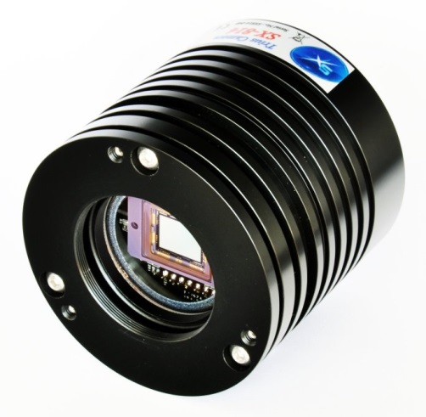
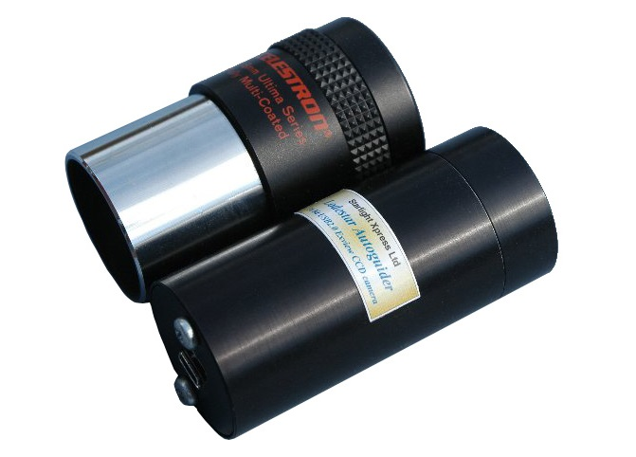
Camera Choice
Imaging camera
Starlight Xpress SXVR-H694
Black and white
Cooled
High sensitivity
Guide camera
Starlight Xpress Lodestar
Sensitive
Low noise
Light

Slide 8
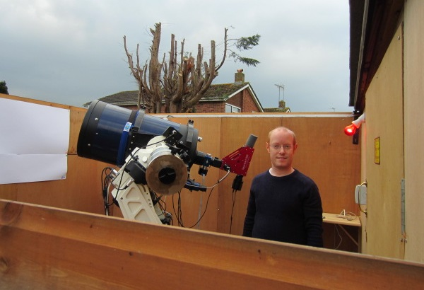
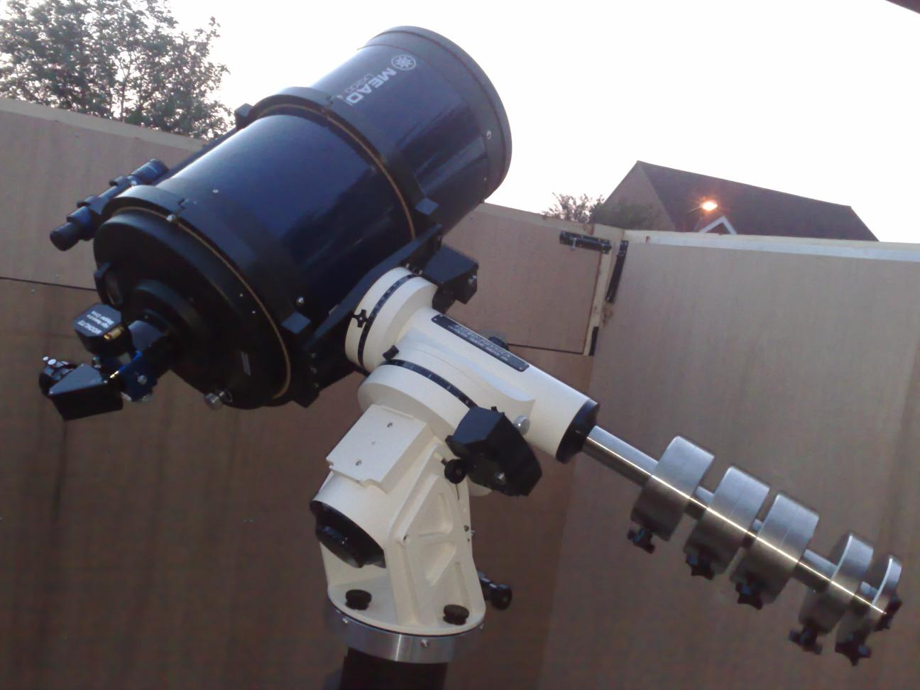
My Old Observatory
14” F10 Meade
AP1200 GTO

Slide 9
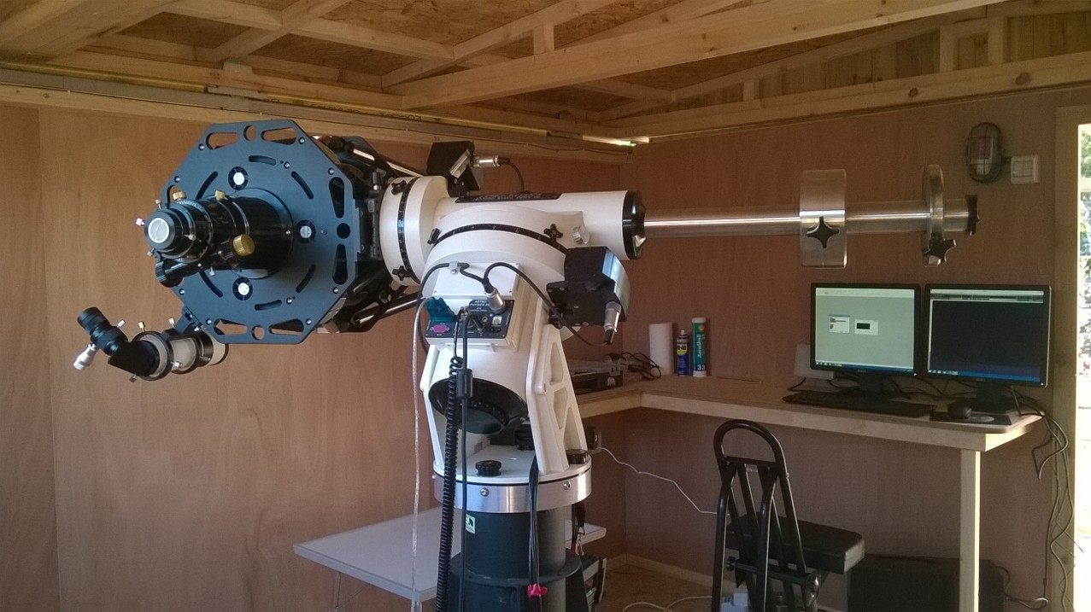
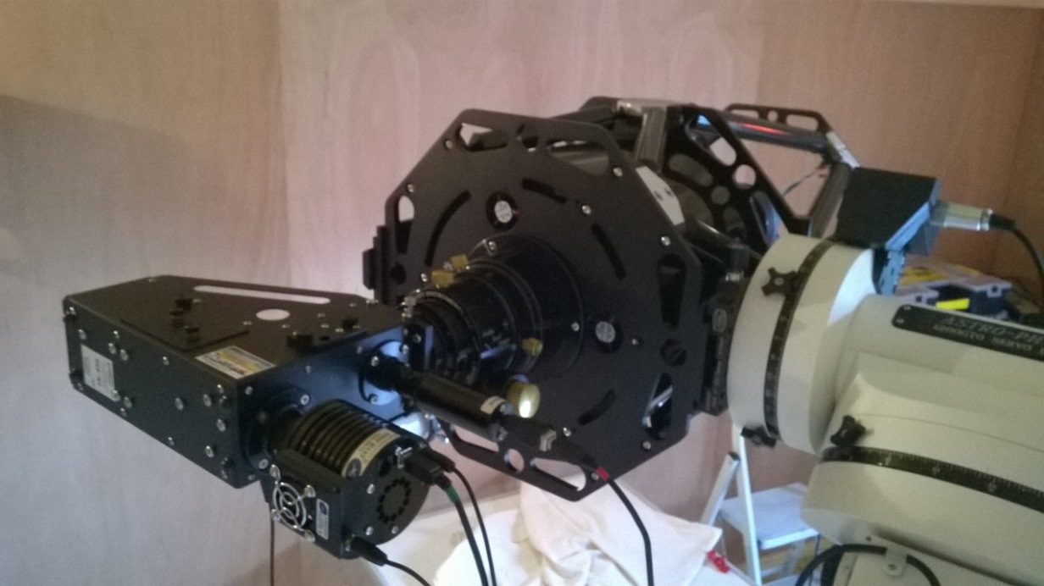
My New Observatory
10” F8 RC
AP1200 GTO

Slide 10
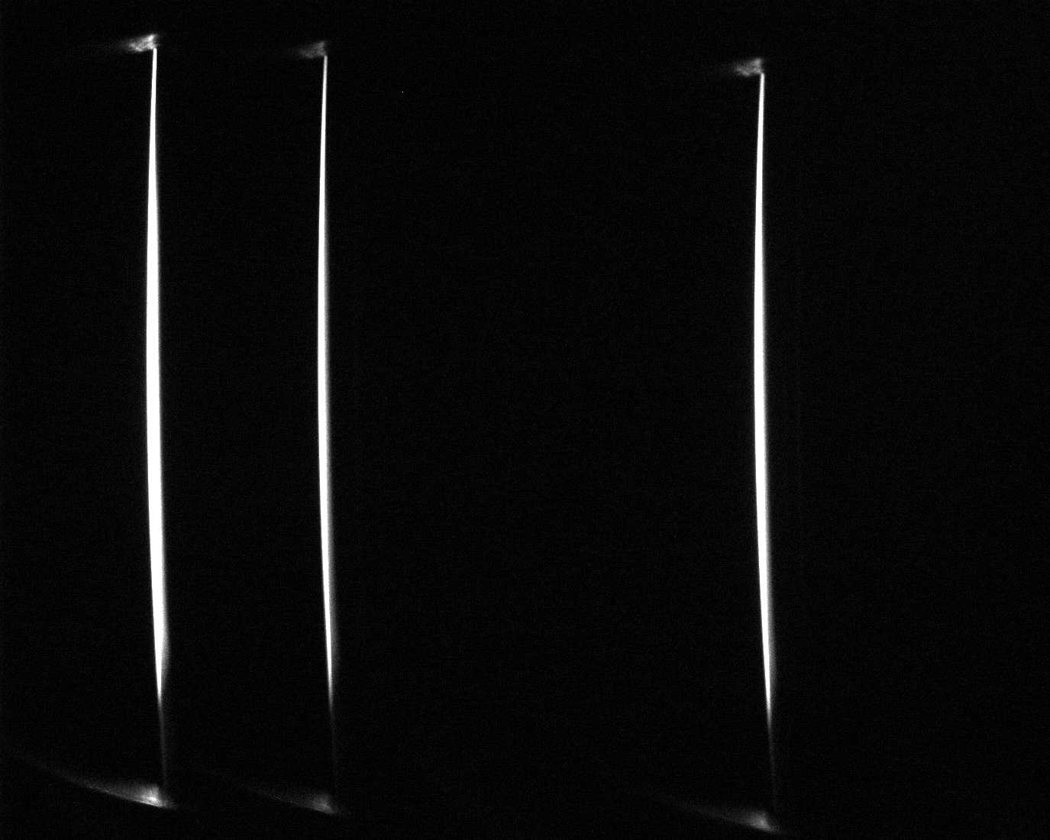
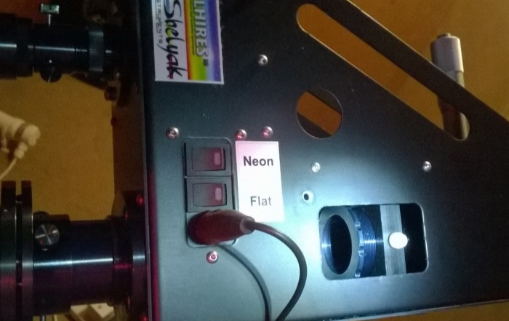
Preparation
First of all practice in daylight and indoors
A good idea to note the micrometre readings for different lines
Spectroscope setup (check at telescope)
Focus the guide camera on the slit
May only need to do once
Select the wavelength
Focus main camera using the neon spectrum

Slide 11
At the Telescope
Focus the telescope on a star
Can do by looking at the guide star image
Refine by looking at the spectrum and focus until counts or signal are highest
May need to nudge star back and forth to centre on slit
Test spectrum to make sure everything is OK

Slide 12
Align Spectra Camera Horizontal Axis
Not aligned (Castor H-alpha at high resolution)
Aligned (CH Cygni at low resolution)

Slide 13
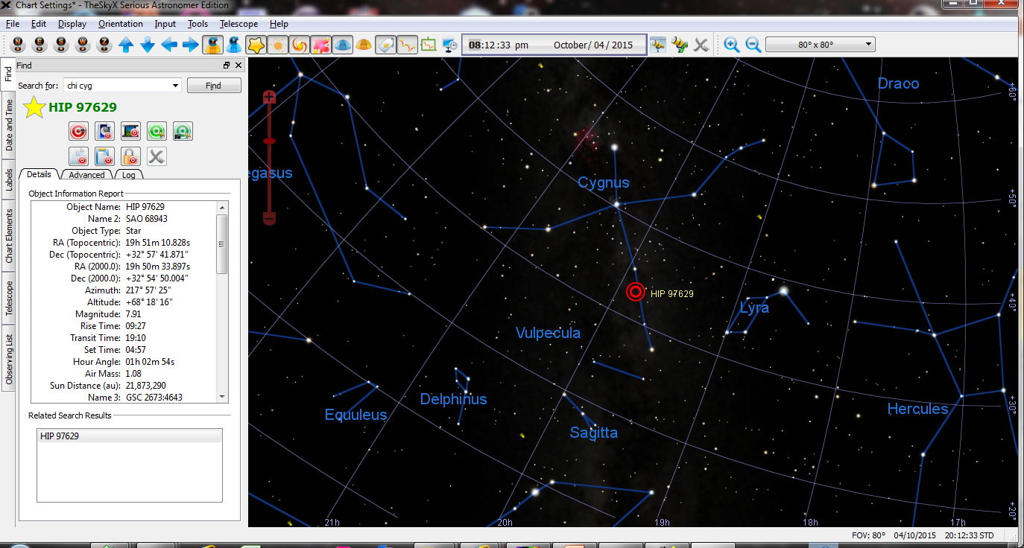
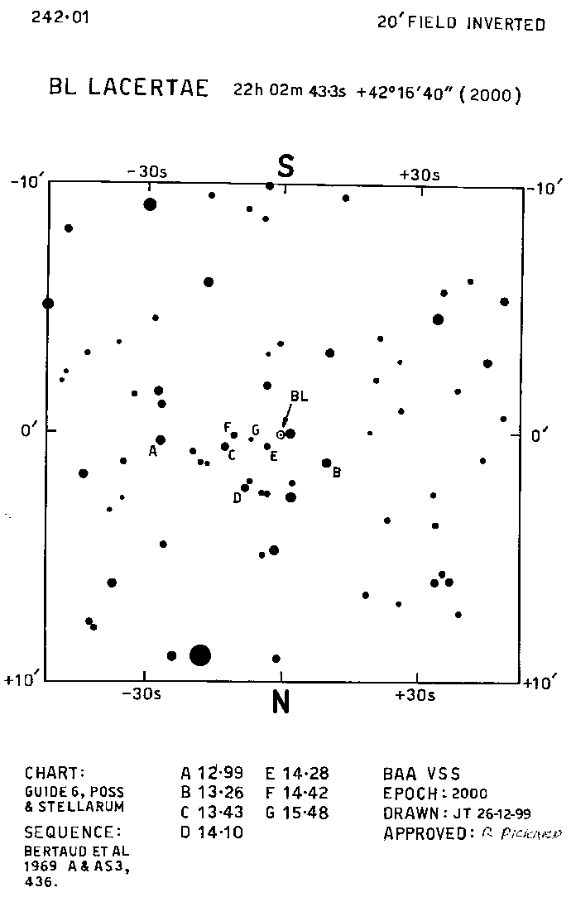
Locating the Star
Planetarium software
BAAVSS
Charts

Slide 14
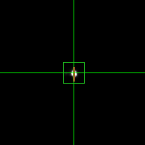
An imaging run – Getting the spectra
Target star
Find the target star
Take a neon spectrum
Position the star on the slit
Track the telescope on a guide star
Take star spectrum images
If long run then take another neon spectrum

Slide 15
Processing a Spectrum Basic Processing
Calibrate all the images
Dark frames
Bias frames (if required)
Hot pixel removal
Combine the images
Correct spectra for “tilt” and “slant”
Wavelength calibrate the spectrum

Slide 16
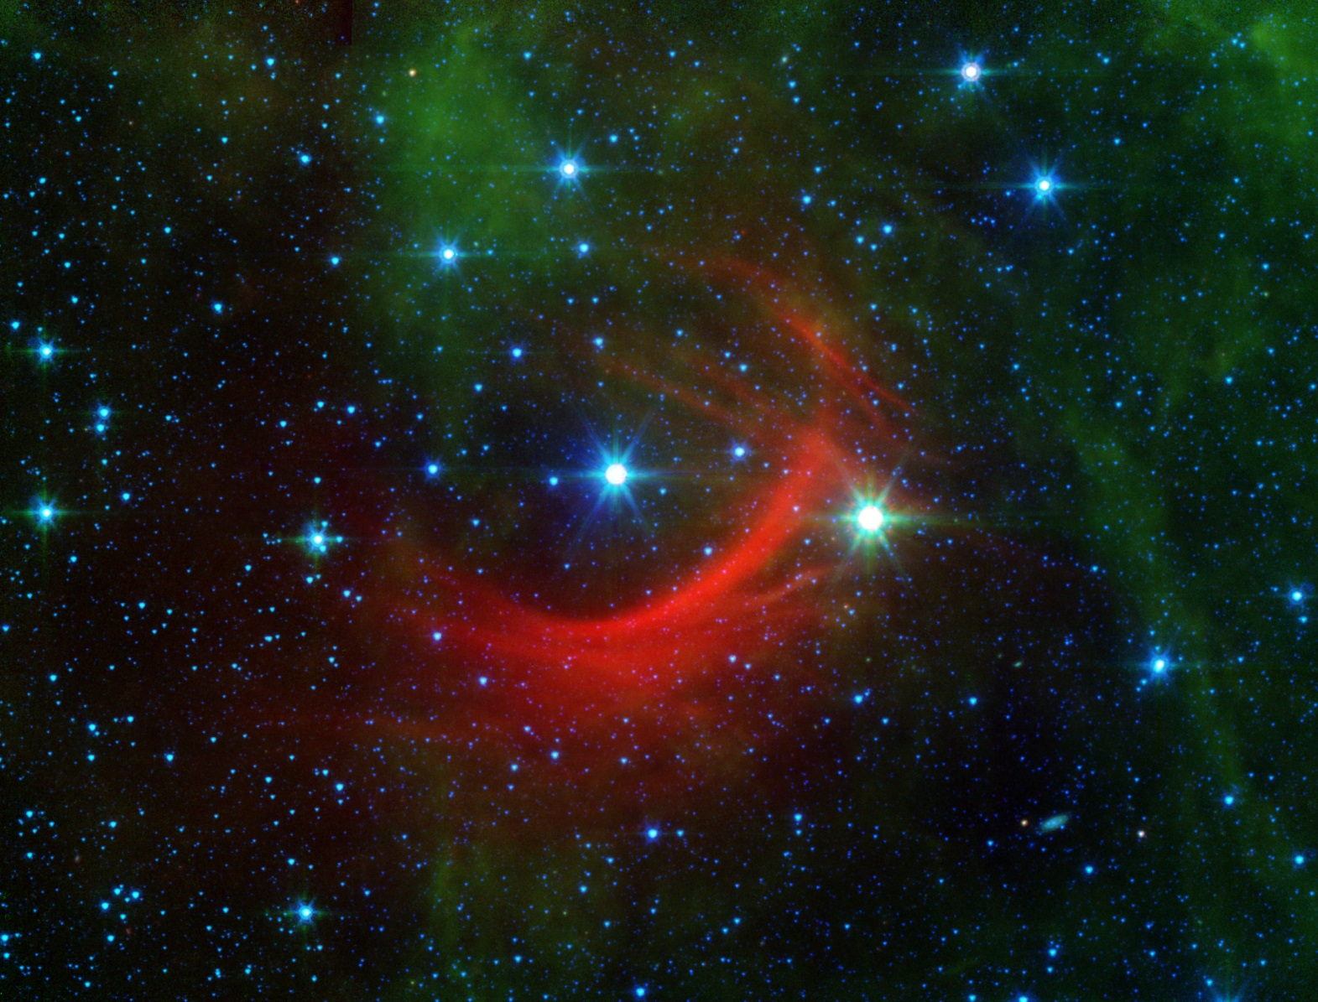
Kappa Cassiopeia
NASA

Slide 17
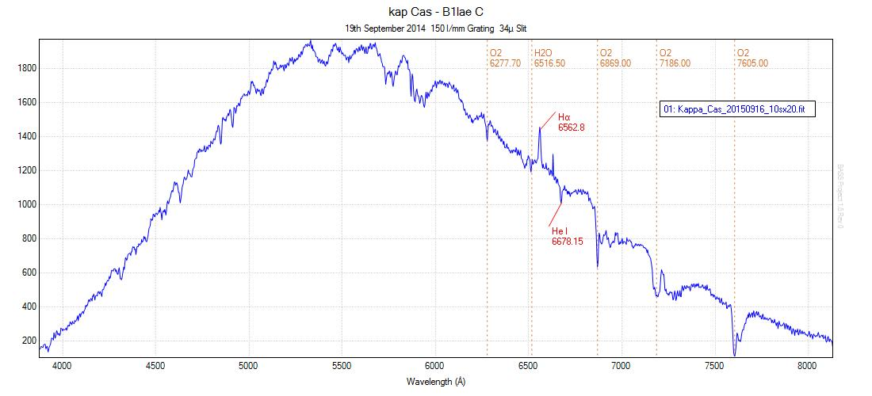
Kappa Cassiopeia Low Resolution – No Response Correction

Slide 18
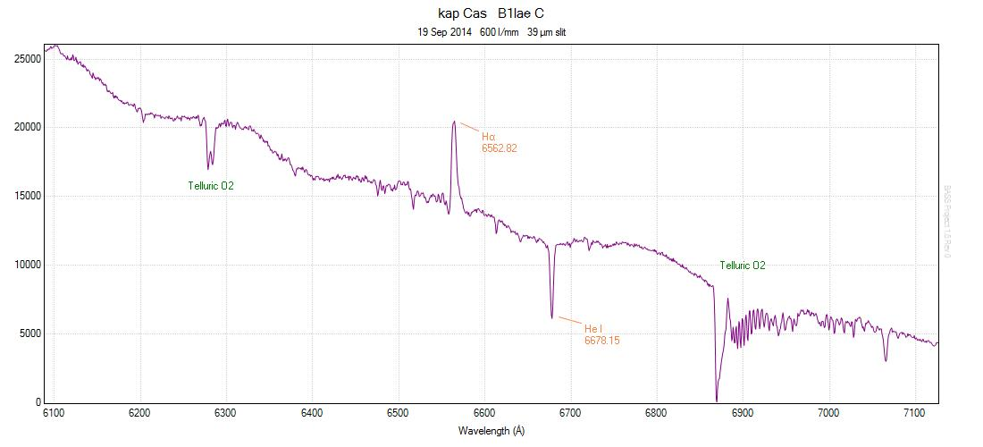
Kappa Cassiopeia Medium Resolution – No Response Correction

Slide 19
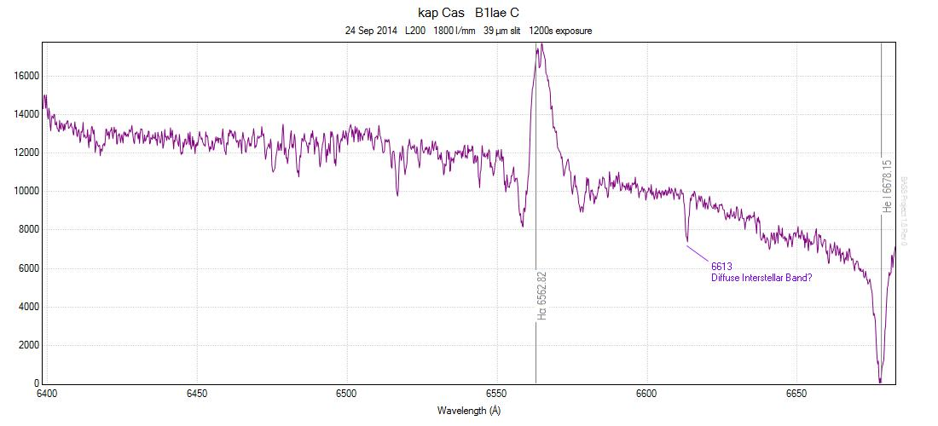
Kappa Cassiopeia High Resolution – No Response Correction

Slide 20
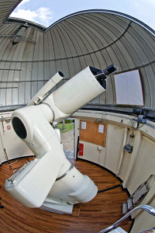
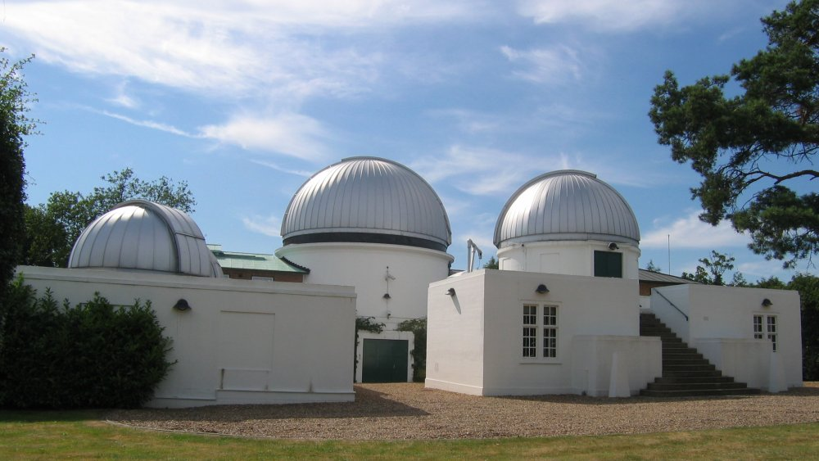
The Allen Telescope University of London Observatory
24” Richey-Chretien

Slide 21
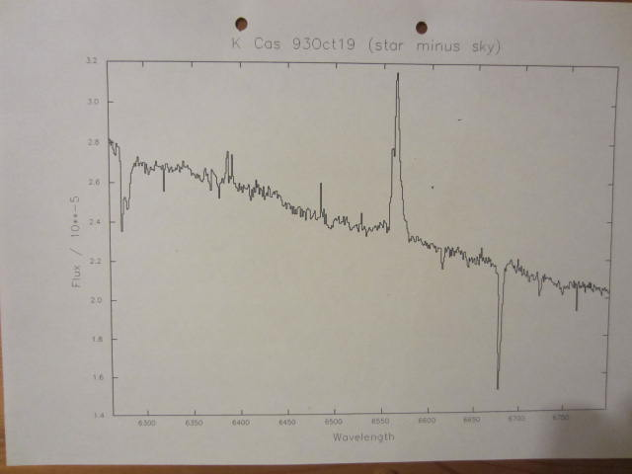
Kappa Cassiopeia Mill Hill Observatory 1993

Slide 22
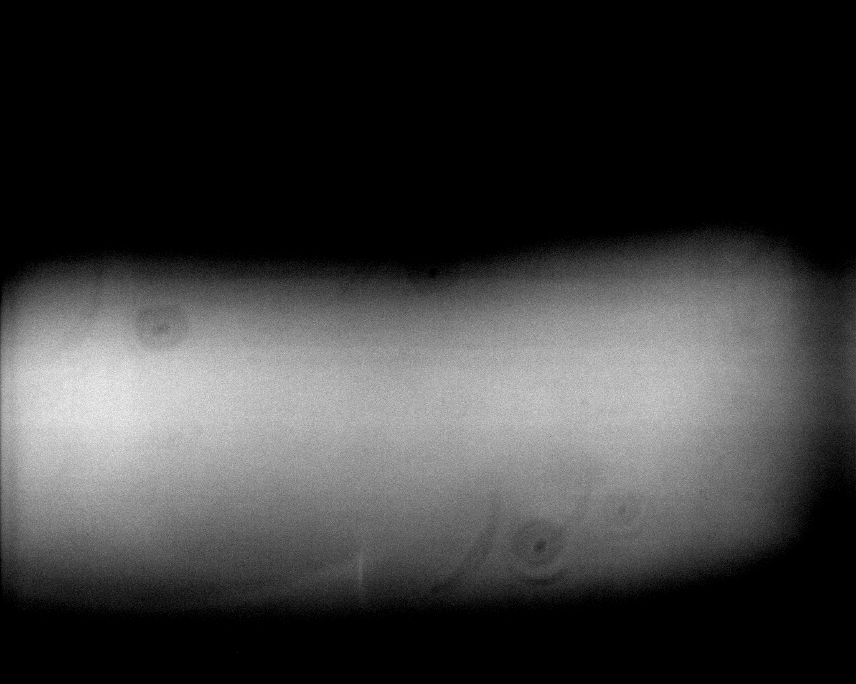
Processing a Spectrum Further Image Calibration
Cosmic ray removal
Flat fields
Removes image artefacts dependent on the spectrum position on the imaging chip

Slide 23
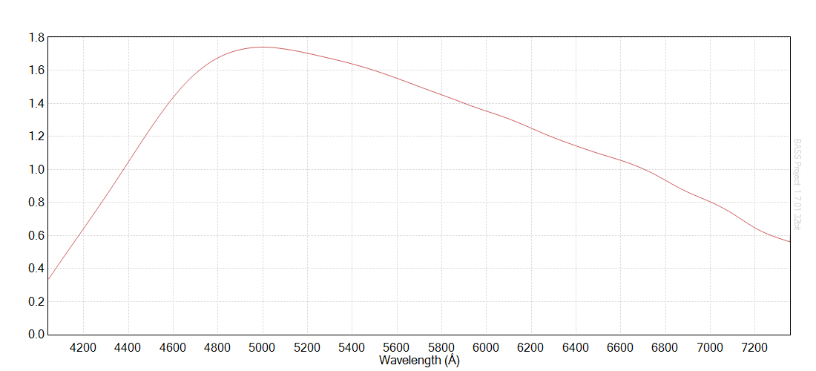
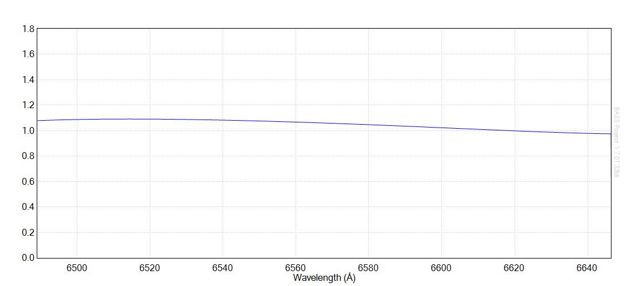
Processing a Spectrum Response Profile – Instrumental and Atmospheric Correction
Take a spectrum of a standard A type star
Close to air mass (altitude) of the target star
Divide this by a professional reference spectrum of the same star
Smooth the resultant curve to remove minor artefacts
This is the response profile!
Used to correct the spectrum of the target star for your equipment and the Earth’s atmosphere

Slide 24
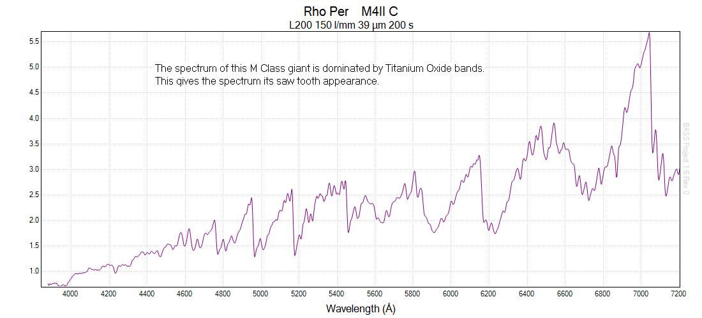
Rho Persei Instrument and Atmospheric Response Corrected but no Flat Field
Red giant with a temperature of about 4000K and a semiregular variable star

Slide 25
Kappa Cassiopeia Flat Field & Response Corrected

Slide 26
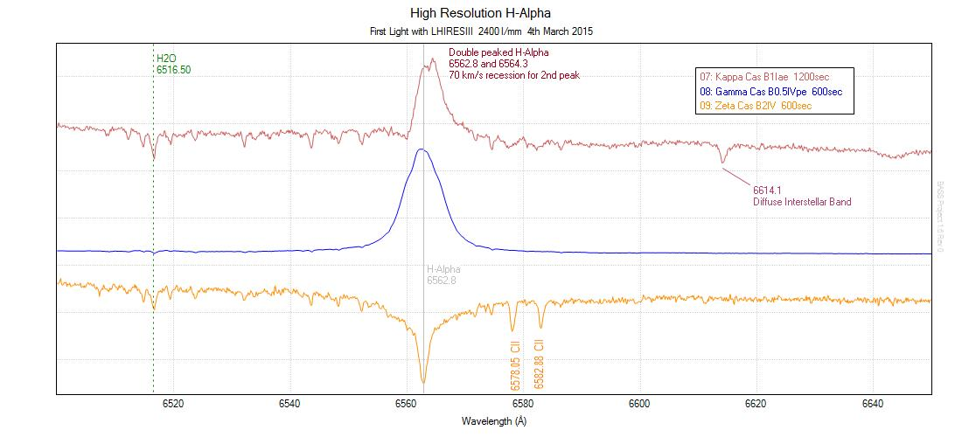
Hydrogen Alpha Line B Stars in Cassiopeia
B Star Temperatures: 15,500K~28,000K

Slide 27
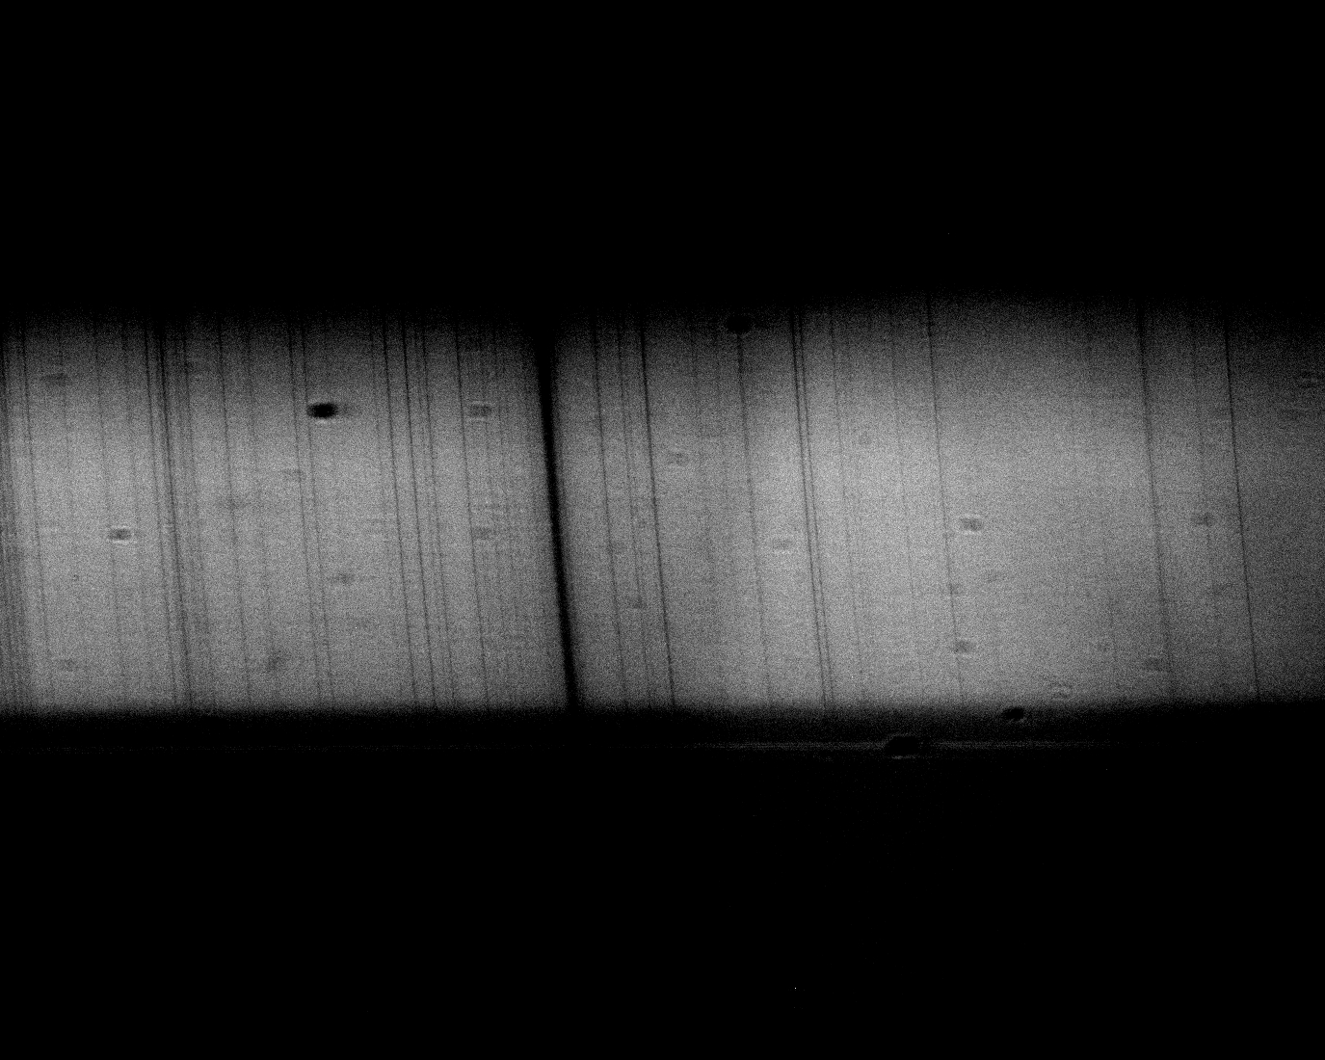
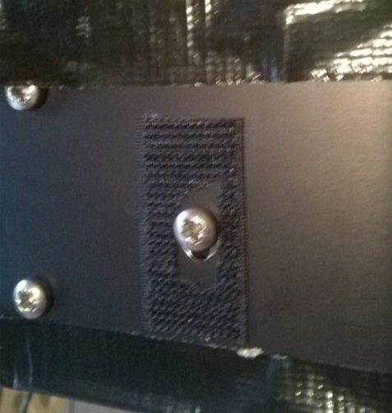
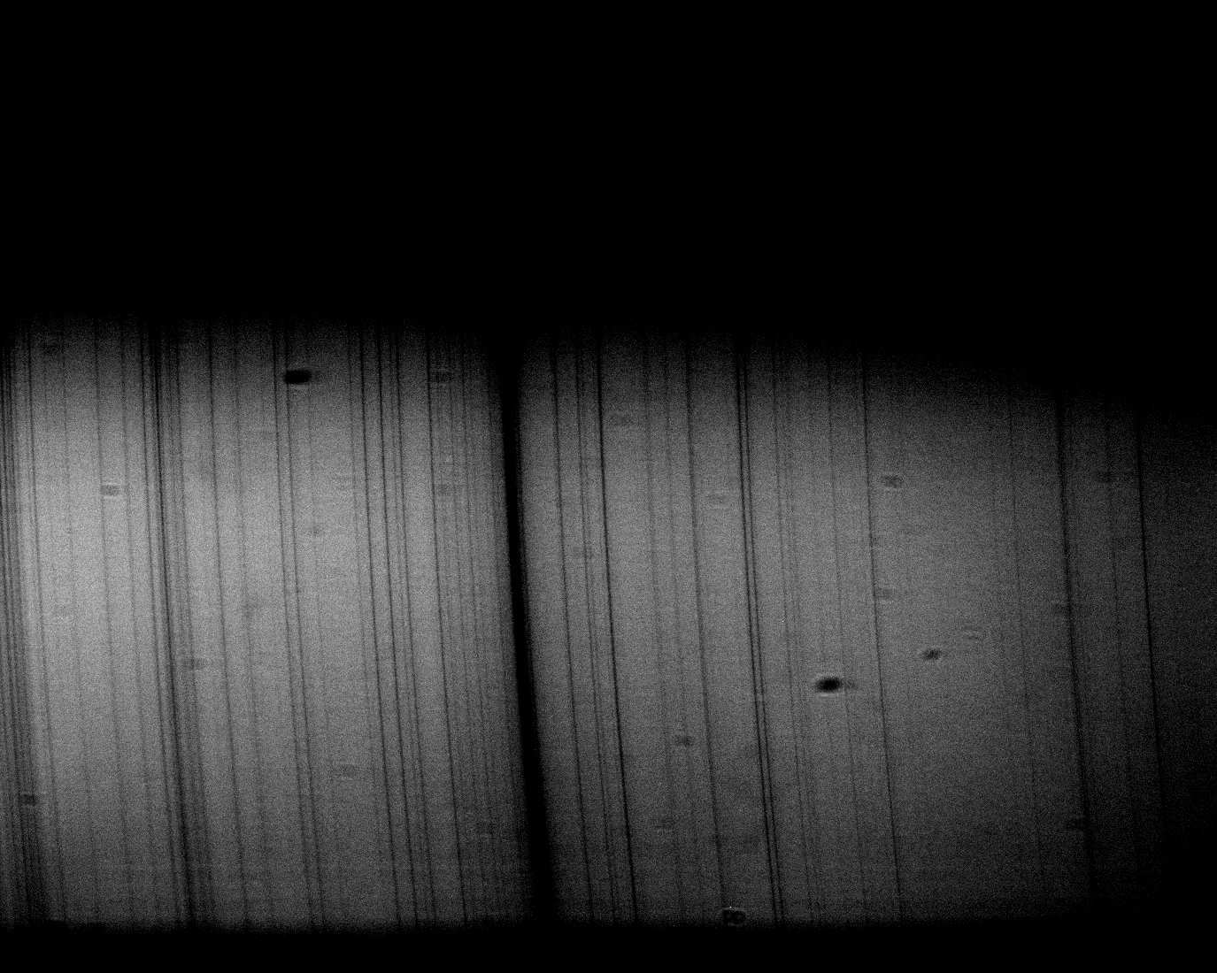
Refining LHIRES III Setup Main Mirror Position
Adjusting the main mirror position on the LHIRES III to optimise the light throughput
Low
Middle
High

Slide 28
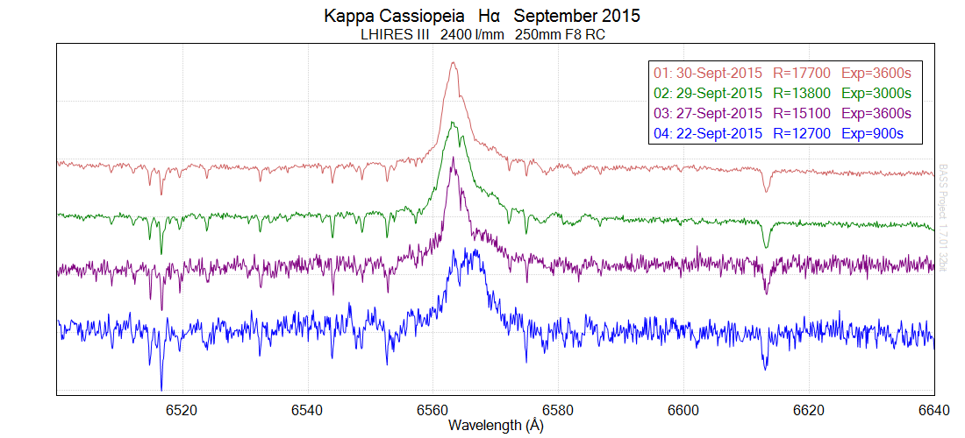
Kappa Cassiopeia Optimising the Spectrograph
Adjusting LHIRES III mirror position
along with telescope and guide camera focus

Slide 29
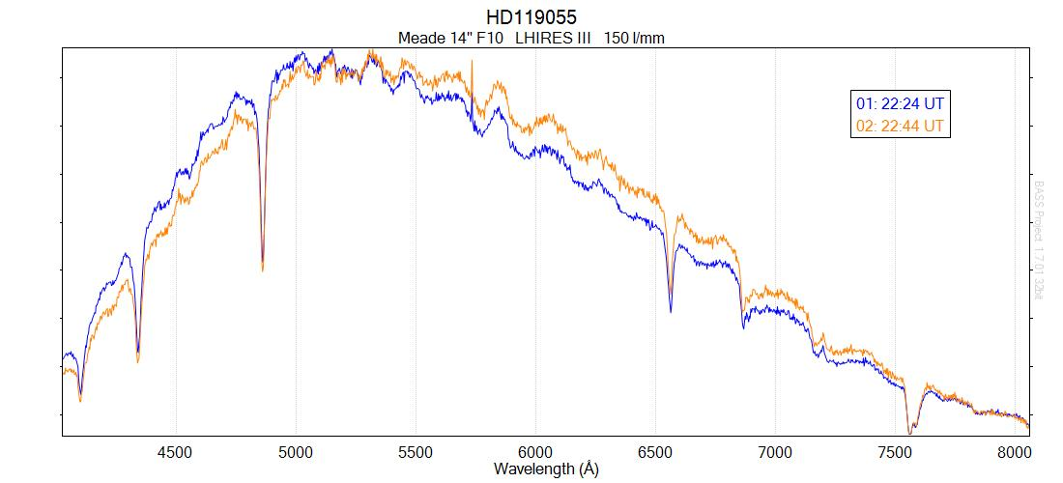
Shift in the Continuum
Over a 20 minute period the recorded continuum of the reference star has shifted.
I suspect this was due to sampling a shifting section of the star’s seeing disk which is subject to atmospheric dispersion.

Slide 30
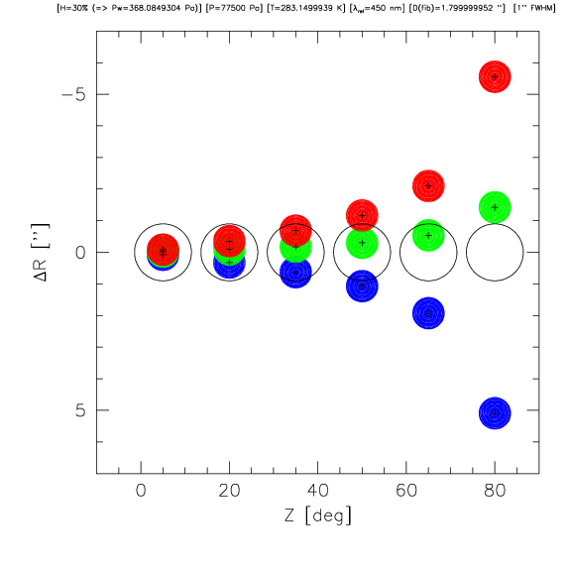
Atmospheric Dispersion
Airy disc
Not a point source and will be subject to blurring by the atmosphere
Atmospheric Dispersion
Difference parts of the seeing disc will preferentially contain stronger red of blue light from the star

Slide 31
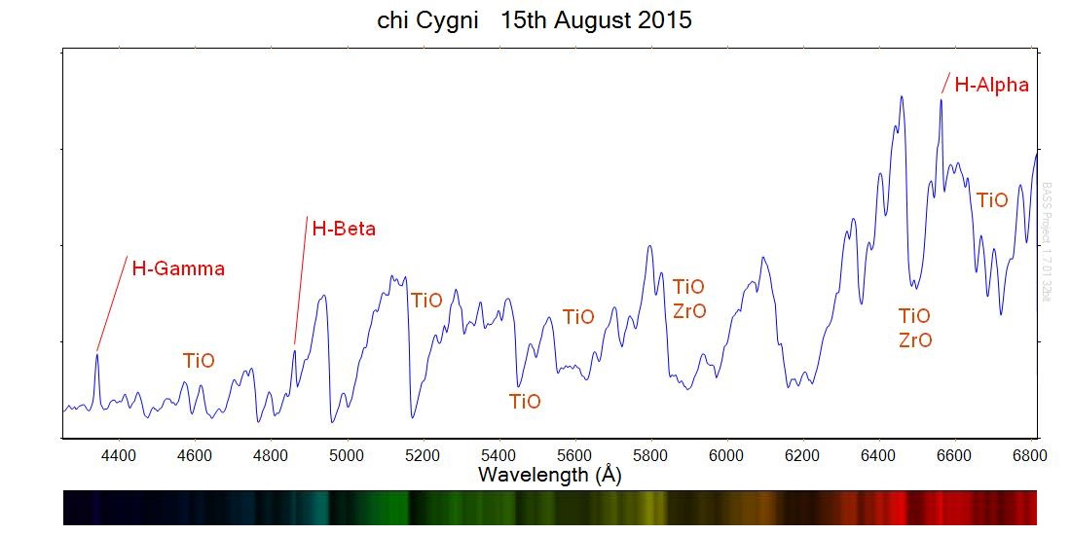
Chi Cygni Mira Type Variable
Low resolution response corrected

Slide 32
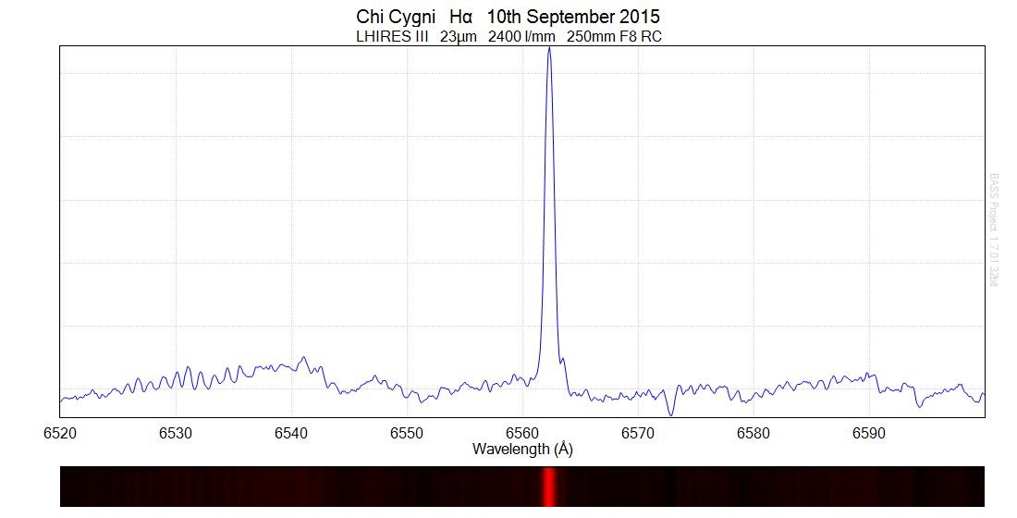
Chi Cygni H-Alpha Mira Type Variable
High resolution response corrected

Slide 33
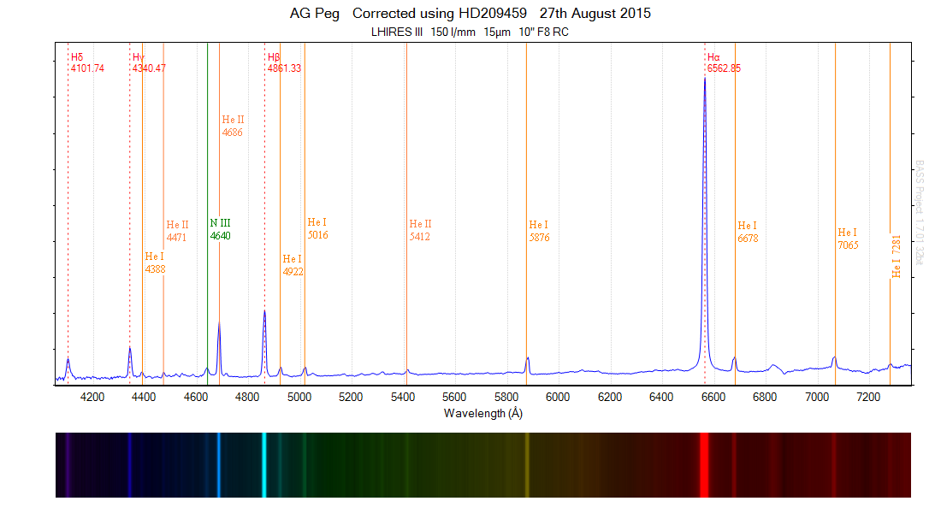
AG Pegasi Symbiotic Star – Red Giant and White Dwarf
Low resolution response corrected

Slide 34
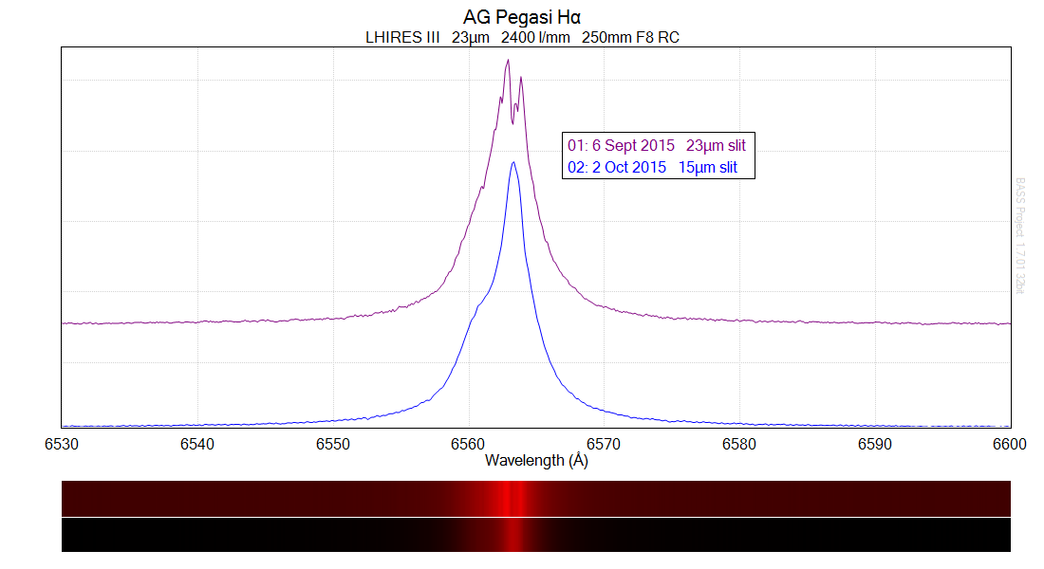
AG Pegasi H-Alpha Symbiotic Star – Red Giant and White Dwarf
High resolution response corrected

Slide 35
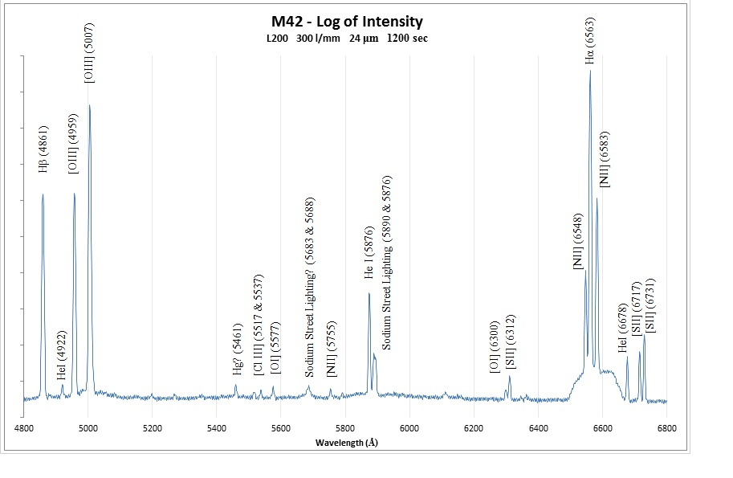
The Orion Nebula

Slide 36
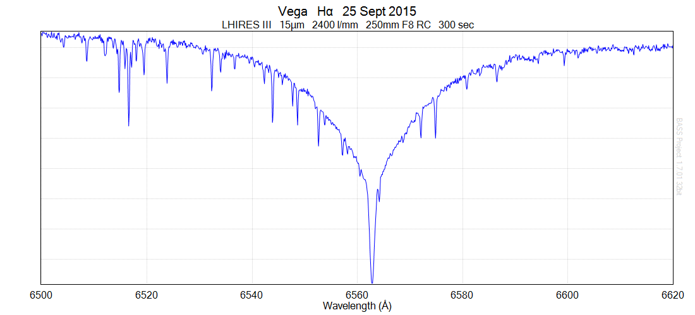
Vega High Resolution & Fully Calibrated

Slide 37
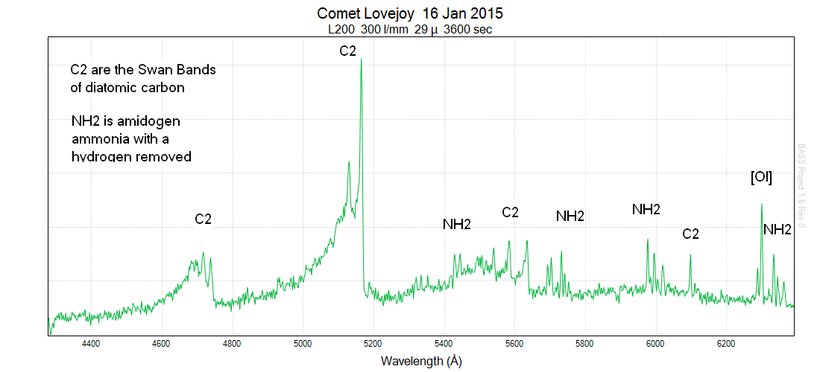
Comet Lovejoy

Slide 38
Processing a Spectrum Further Enhancements - Future Challenges!
Improved wavelength calibration
Use telluric lines around H-Alpha
Flux calibration
Gives the actual energy received from the star at different wavelengths
Removal of interstellar reddening
Corrects the spectrum for the effects of interstellar dust that absorbs more blue light than red light

Slide 39
Future Projects
Variable stars of all types
Radial velocity measurements
Galaxy rotation
Be stars
Detailed analysis of nebulae emission line

Slide 40
Further Information
Wikimedia Commons used as source for many images:
http://commons.wikimedia.org/wiki/Main_Page
Spectroscopy Yahoo Groups
https://groups.yahoo.com/neo/groups/astronomical_spectroscopy/info
https://groups.yahoo.com/neo/groups/spectro-l/conversations/messages
ARAS – Astronomical Ring for Access to Spectroscopy
http://www.spectro-aras.com/forum/index.php
British Astronomical Association Variable Star Section
http://www.britastro.org/vss/
Online Astronomy Society Astronomical Spectroscopy Facebook Group
https://www.facebook.com/groups/362613490511970/
Me – Andy Wilson: barnards.star12@gmail.com

