Slide 1
British Astronomical Association
Radio Astronomy Group
Schumann Resonance Sensor
Our Journey to First Light
16 October 2021
Norman Pomfret M0SXF

Slide 2
Norman Pomfret
Member BAA’s Radio Astronomy Group
Trustee UK Radio Astronomy Association
Member Radio Society of Great Britain M0SXF
Member Monmouth Astronomical Research Society (MARS)
Hereford Astronomical Society
Likes Hills, Mountains, Radio, Electronics and …

Slide 3
Every project has a Start
This presentation is about our journey or Endeavour
To design & construct a Schumann Resonance Sensor
Capture our First Light Schumann Resonance, then monitor
As ever constrained by Commitments & Cost
Then ! One day have a worthy scientific instrument

Slide 4
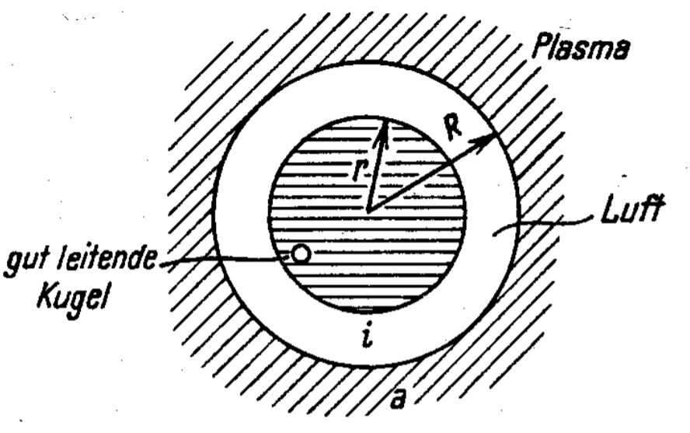
Schumann Resonance, History
1893 George Fitzgerald
1905 Nikola Tesla
1952 Winfried Schumann
1960 Basler and Wagner
Then there was great interest
in Schumann Resonance …
Credits Wiki

Slide 5
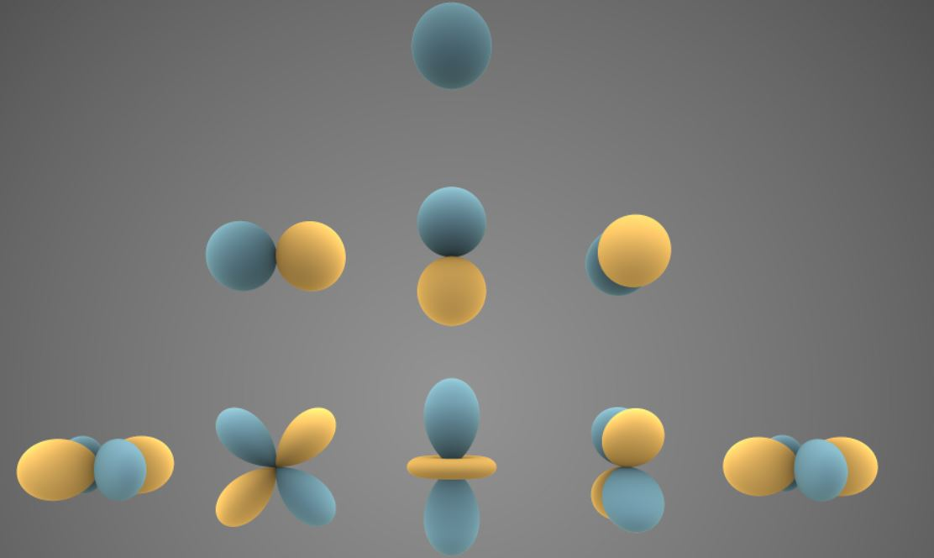
Schumann Resonance, two icons
2 Dimensional representation
Spherical Harmonics
Credit NASA

Slide 6
Schumann Resonance, global effect of Lightning
Resonance of the Earth-Ionosphere waveguide (Waveguide)
It is not unique to our Earth evidence of SR on Mars & Gas giants
Have very long wavelengths and a low attenuation rate
Modes occur at approx. 8, 14, 20 Hz and towards 100 Hz
But !

Slide 7
Schumann Resonance, bespoke hard & software
Induction coil with an E screen, 100,000 turns est
Low noise amplifier with high gain, balanced input
Balanced line receiver, 600R input, ~ 50m distant
Digital Signal Processing (DSP) Software
Small Board Computer (SBC)
Power supply; Test and Calibration equipment

Slide 8
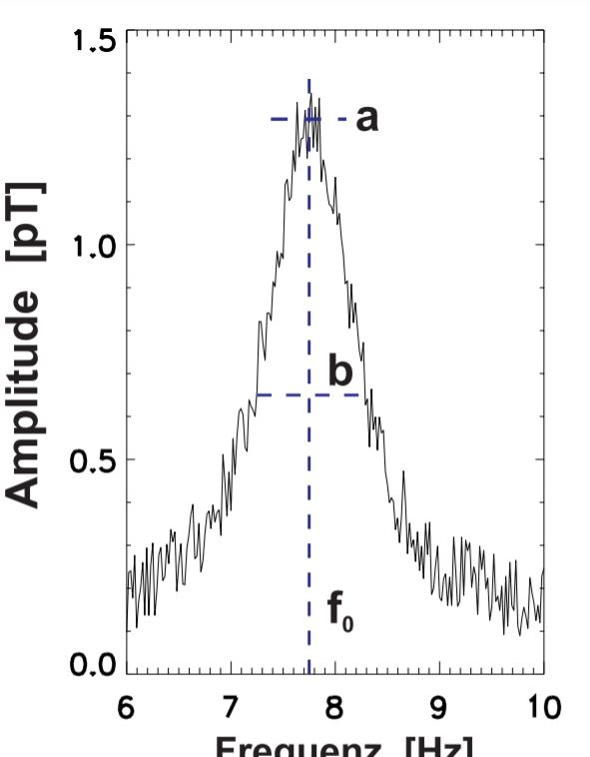
Schumann Resonance
a Peak amplitude
b Q waveform width at -3 dB
f_{o} Frequency of the peak
First mode is illustrated there are many modes first three 3 are required for a valid observation
A

Slide 9
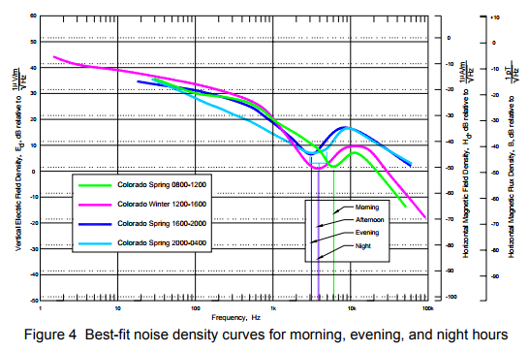
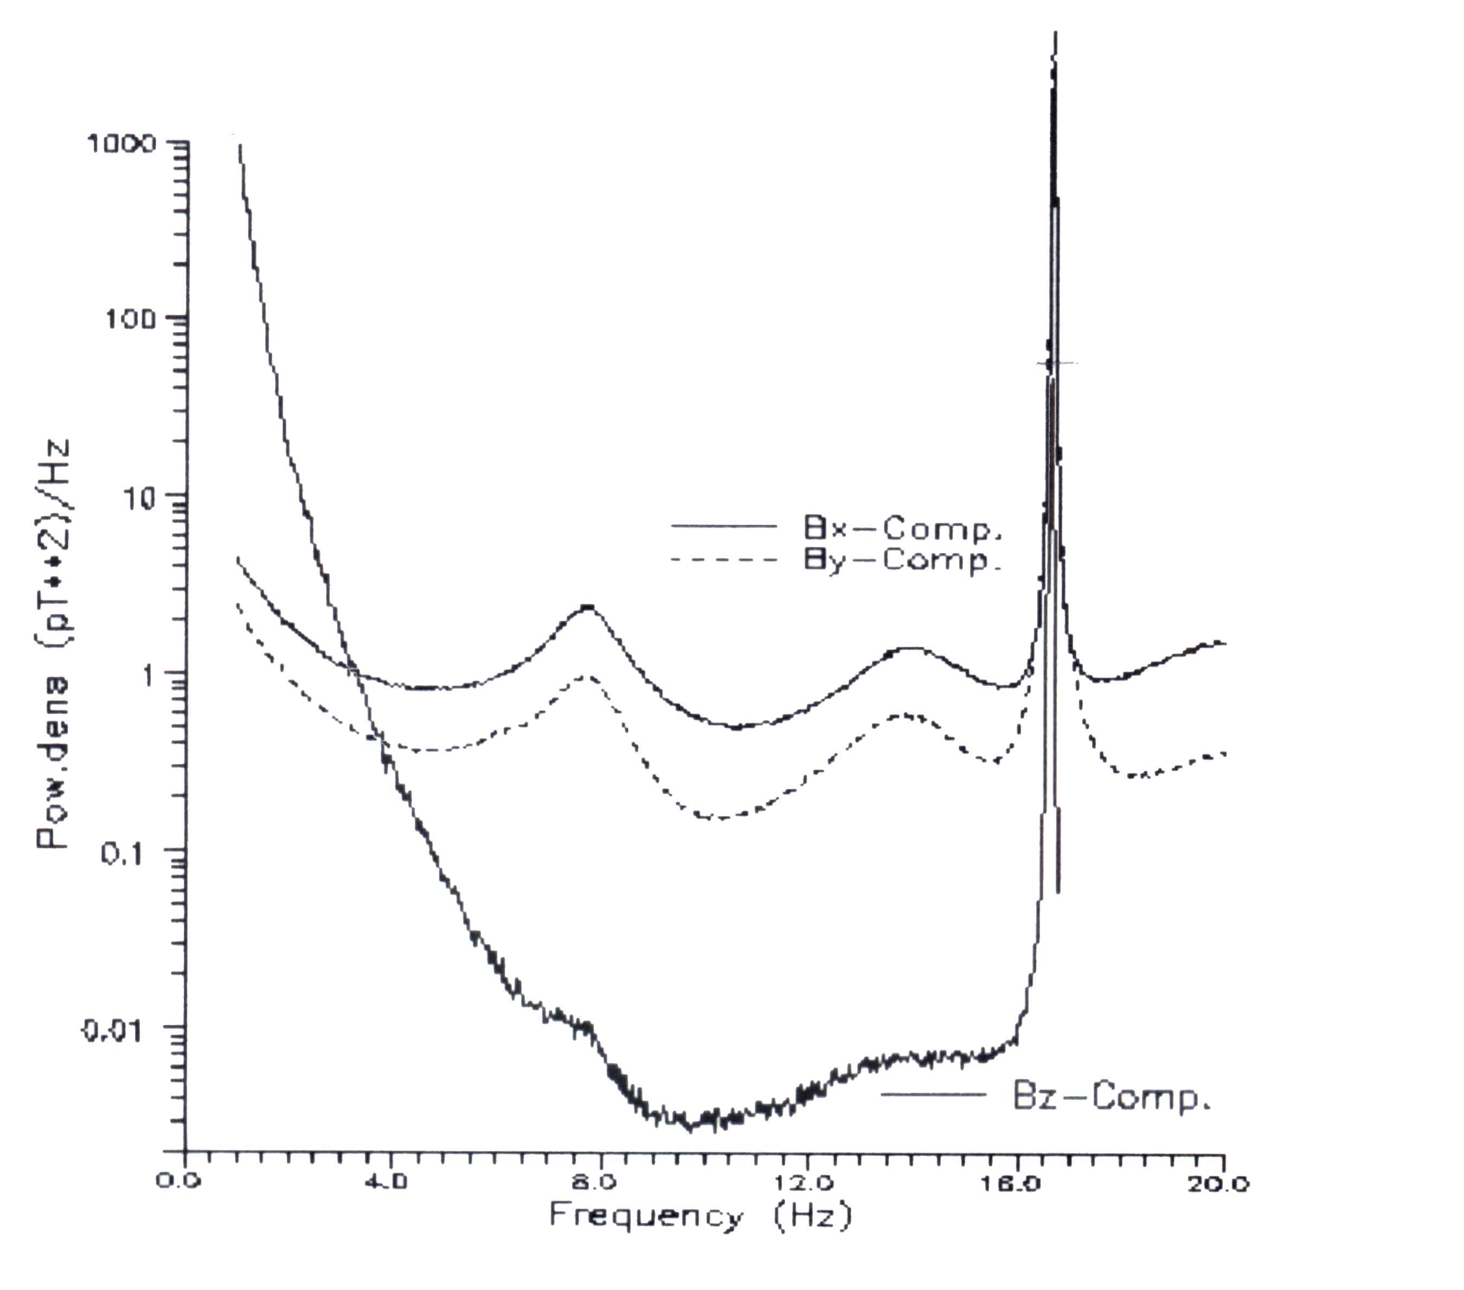
Schumann Resonance, Where it is found !
The Background Noise, Replicated Peter Molloy
SR Signal, 2modes only at 8 & 14 Hz

Slide 10
Schumann Resonance, How ! Our Plan
Concept design by
Laurence Newell

Slide 11
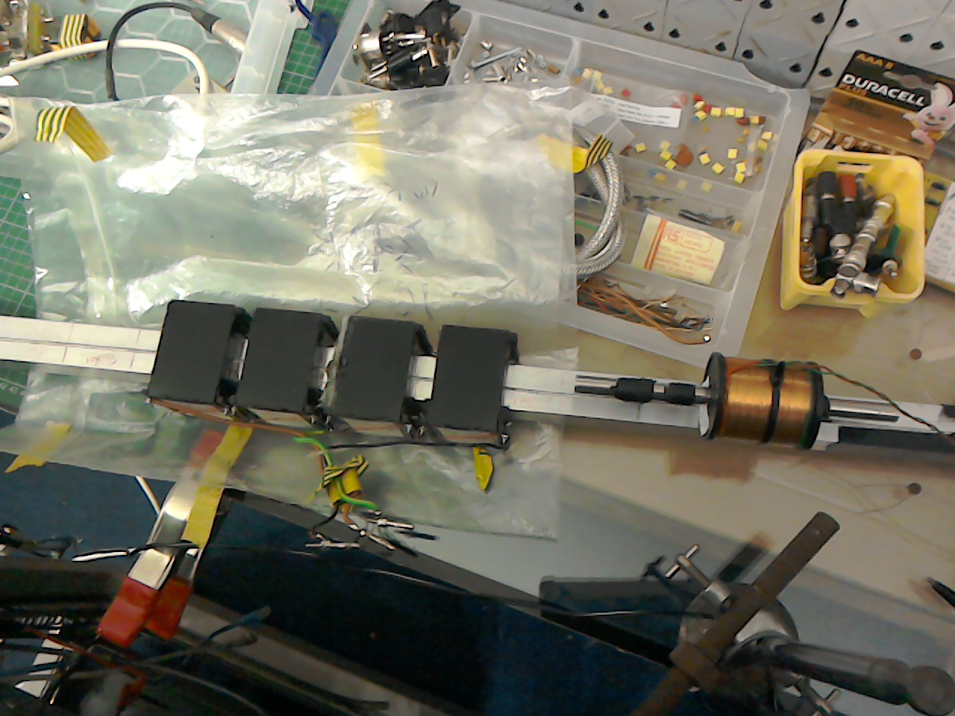
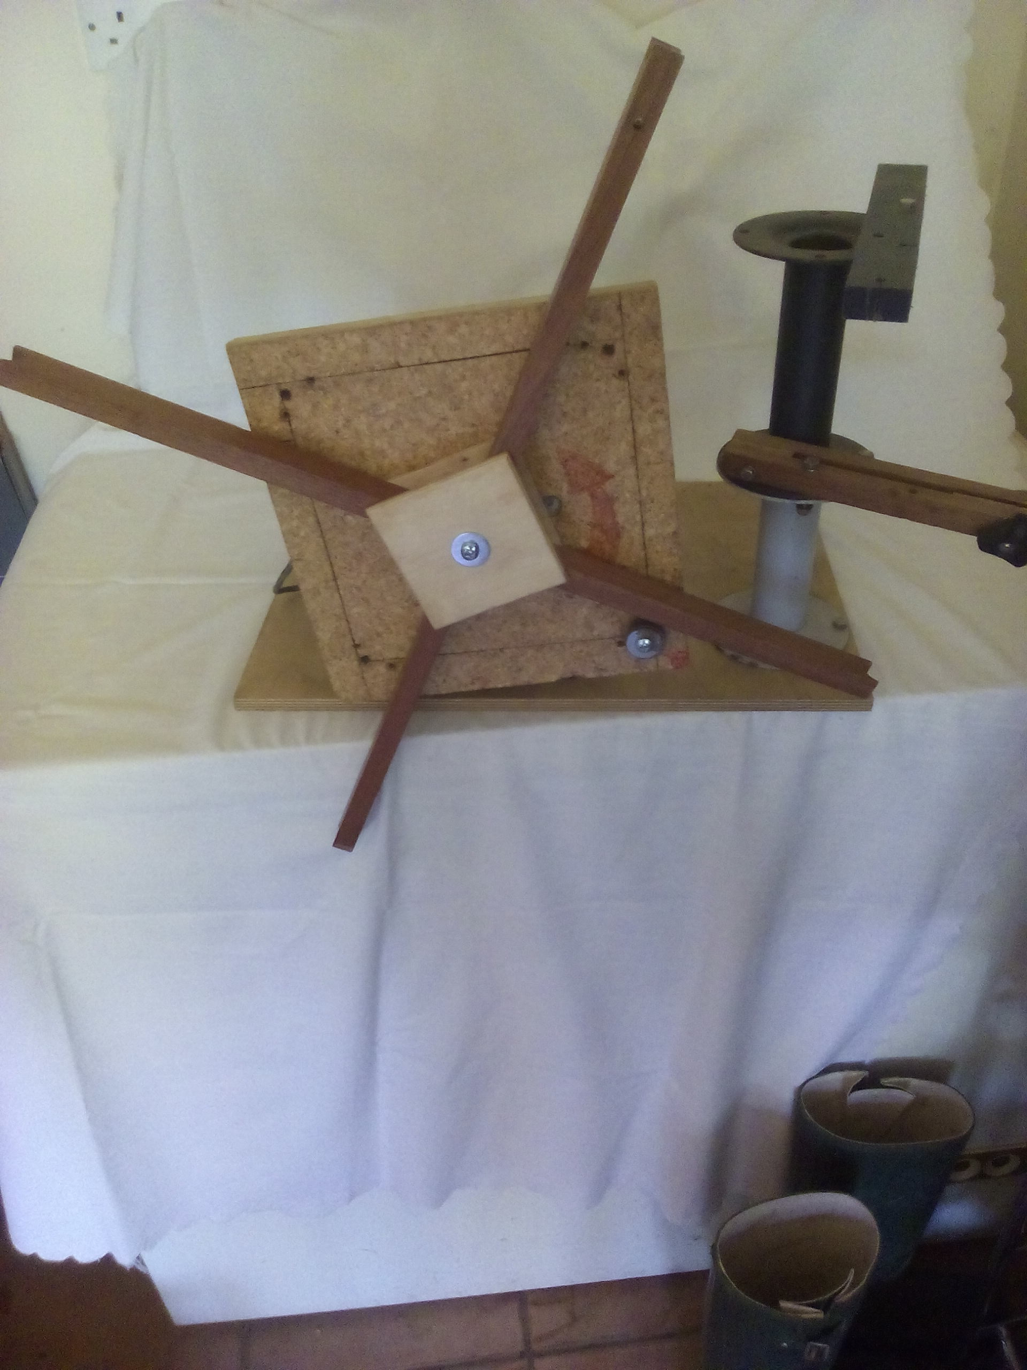
Schumann Resonance, Early days testing coils
A bigger Coil Winder for VLF Loop Aerials
Coil Evaluation

Slide 12
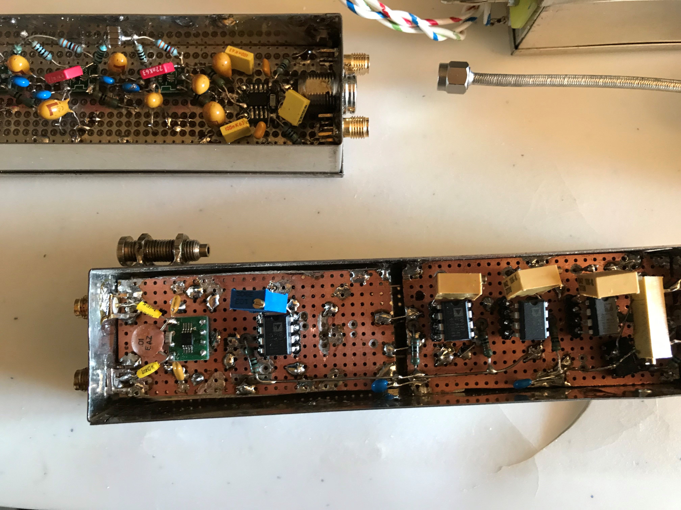
Schumann Resonance, So where did we start !
Developing stage by stage

Slide 13
Schumann Resonance, Low Noise Amplifier
Design by
Laurence Newell

Slide 14
LNA sch

Slide 15
LNA pcb
KiCAD rendition of the assembled PCB E card

Slide 16
Schumann Resonance, Balanced Line Receiver
Design by
Laurence Newell

Slide 17
BLR sch

Slide 19
Design by
Laurence Newell

Slide 21
Schumann Resonance, Balanced Noise Source

Slide 22
Schumann Resonance, Signal Source in development
The signal source will be similar in style, 0 dB into 600 R balanced
Attenuator modules for very low level outputs, to the LNA
Additional Amplifier for a higher level output to the BLR
And a Coil driver for a small induction coil, for polar calibration plots

Slide 23
Schumann Resonance, First Light Signal
There is a peak at approx. 2 Hz, this is not a Schumann Resonance, Marine ?
The fundamental Mode is seen at approx. 8 Hz
2nd and 3rd modes are also seen,
Perhaps a 4th & 5th in the noise
Signal processed via GNU Radio

Slide 24
Schumann Resonance, A happy band of well wishers

Slide 25
Schumann Resonance, Our Conclusions
We have detected the Schumann Resonance
Though, sample size was short & overwhelmed by 50 Hz
Whilst our hardware designs were successful
DSP Software needs further development
Our Induction Coil requires refinement
Earthing strategies to be refined to defeat ‘Hum’

Slide 26
Schumann Resonance, further reading
‘ELF Electromagnetic Waves from Lightning’ The Schumann Resonances
Dr Colin Price
Recommended to me by
Dr Ciaran Beggan
British Geophysical Survey
ISBN (2014)
978-4-431-54357-2 hb
978-4-431-54358-9 ebook
Tyros is Greek for
‘Beginners’

Slide 27
With grateful appreciation to the many, for their advice & assistance offered and specifically to:
Dr Ciaran Beggan # John Cook Alan Melia Dr David Morgan Dr Laurence Newell.
# British Geophysical Survey, Edinburgh

Slide 28
Post Script
At home, our telecoms provider (to be) said some time ago –
You can have FO Broadband before the New Year Great, I thought
However they did not say which New Year !
4G is looking more attractive : )) by then it will be 5G or 6G !
Thank you for your forbearance

Slide 29
Schumann Resonance, Closing thought
It is suggested that a Super Nova event would seriously disrupt
the Schumann resonance
Just hope,
such an event is not too close !
Thank you
for listening

