Slide 1
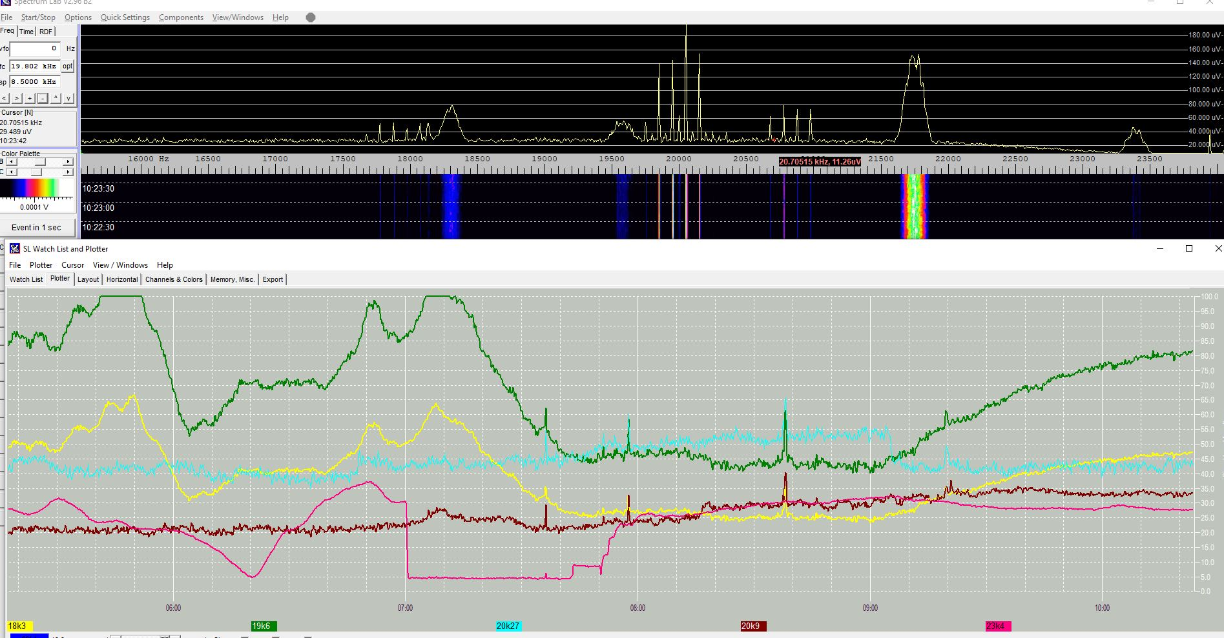
Sudden Ionospheric Disturbance and Detection using Spectrum Lab
John Berman
March 2026

Slide 2
Who is John Berman
Keen Astro-Photographer and then moved to Radio Astronomy
and started with Meteor Detection via Graves and then via the Uk Beacon
Keen website creator
Radio Meteor Detection collaboration project website running since . 2017
https://radiometeordetection.org/
UK Meteor Radar Project Website
https://ukmeteorbeacon.org
Under Development and coming soon
Website coming fire the VLF Archive
Website coming for the Muon Project

Slide 3
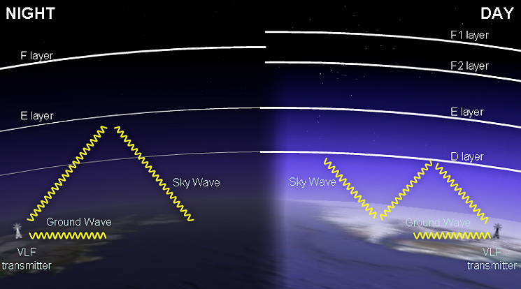
Sudden Ionospheric Disturbance's (SIDs) and their detection
A Sudden Ionospheric Disturbance (SID) is a rapid change in the Earth’s ionosphere caused mainly by intense radiation from the Sun, especially during solar flares. These disturbances can temporarily disrupt radio communications on Earth.
A SID occurs when a strong solar flare emits intense X-rays and ultraviolet radiation that reaches Earth in about 8 minutes.
This radiation:
Suddenly increases ionization in the ionosphere, especially in the D-layer.
The D-layer becomes much denser than normal.
Instead of reflecting radio waves, it absorbs them strongly.
With simple non expensive equipment we can detect SID’s

Slide 4
Basic Setup
Antenna
100m of Enamelled Copper wire 22 AWG and wound it round a home-made wooden frame which is 60 cm square
External USB Sound Card
I sourced an external USB Sound Card, key point being ideally get a one that can support 96 khz sampling rate, that way it can receive radio signals up to 44 khz. Simply connect the two antenna wires to a Jack and the Jack plugs into the mic socket on the USB Device
Spectrum Lab
You can download Spectrum lab and install, there are some basic settings, and you will need a configuration file ( there are plenty available)

Slide 5
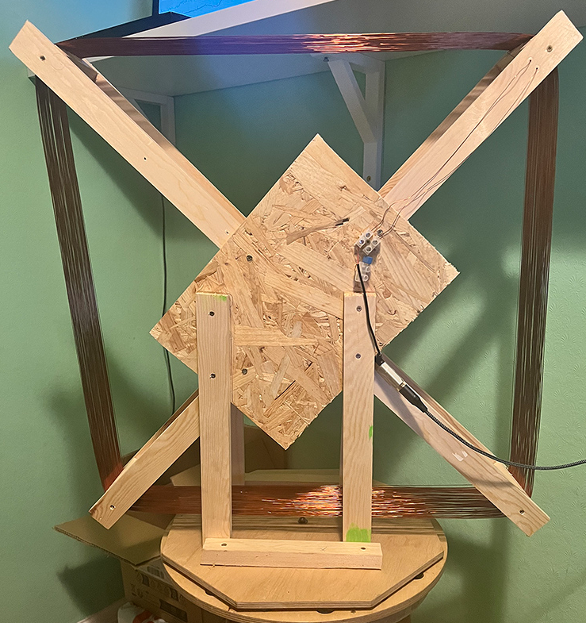
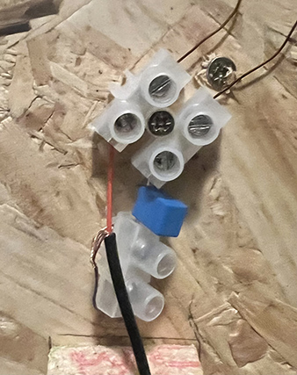
Antenna and the Connections

Slide 6
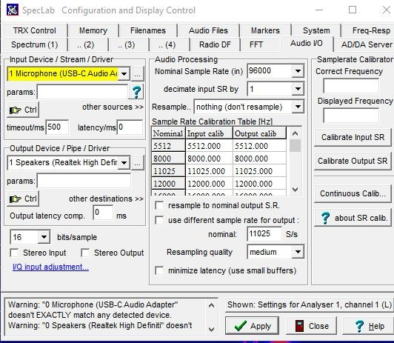
Spectrum Lab
Spectrum Lab is a mature product there is link in the Reference Slide
There are lots of setting, but all controlled by a configuration file - there is a link to mine in the reference slide, mine is
not perfect but it will get you going – a key setting will be to choose the input device – Shown here in yellow
Notes:
Talk about SL

Slide 7
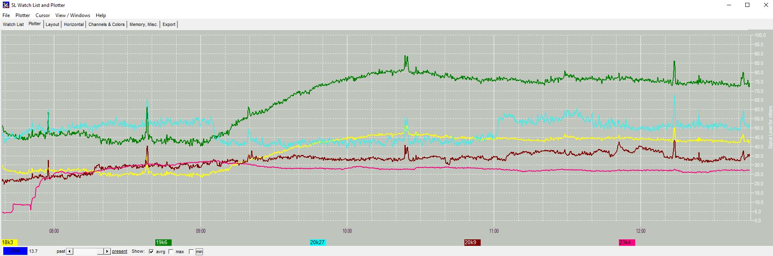
Plot Window
This is what my plot window looks like – Spectrum Lab can monito more than 1 frequency, it’s a good idea to at least
monitor 2 or more frequency's
Notes:
Talk about the plot window l and do a live demo

Slide 8
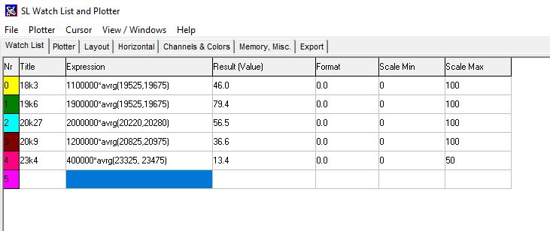
Plot Window
The Watch List is where you set the frequency's to be monitored
It’s a good idea to monitor more than one frequency
18.3khz - French Navy Rosnay, France
19.6khz Royal Navy, Anthorn, UK
20.27khz NATO / Italian Navy, Isola di Tavolara, Italy
20.9khz French Navy St. Assise, France
22.2khz French Navy Rosnay, France
23.4khz NATO / Ramsloh, Germany
Notes:
Talk about the watch list and do a live demo

Slide 9
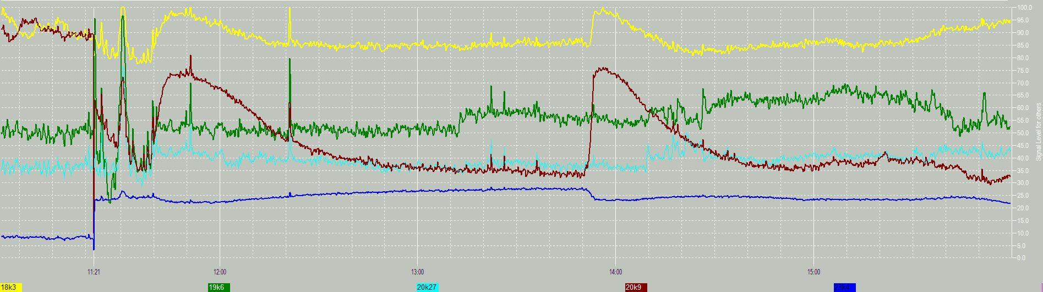
This is my first SID Capture
08 February 2026 @14:00 GMT

Slide 10
My SID Site
As I have an interest in websites, I have created a site and the plots from Spectrum Lab are uploaded to my site and added
to a MySql Database, this is done using a Python Script (developed using AI)
So, on my site I have a plot archive and a page which shows the latest plot.
I'm currently experimenting using AI to look at the plots and highlight any potential SIDS.
Notes:
Do a live demoe

Slide 11
Useful Sites
These instructions were written by Paul Hyde and whilst they were written a few years ago they work just fine Monitoring SIDs using Spectrum Lab and USB Sound Cards
A very compressive SID site created by Lionel Loudet and a good reference to check against
https://sidstation.loudet.org/home-en.xhtml
My Website
https://sid.radiometeordetection.org/
My Web site also has additional information on my setup
Notes:
Add some more reference info

